Slide 1
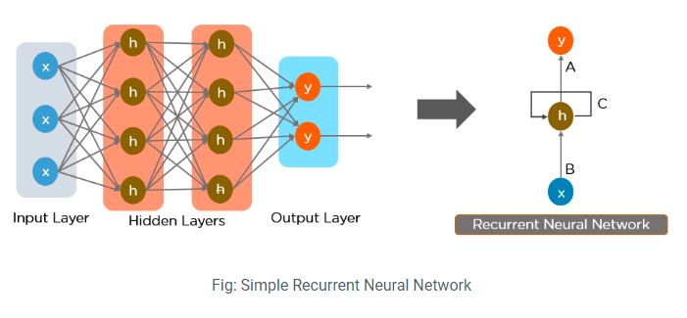
Recurrent Neural Network (RNN)

Slide 2
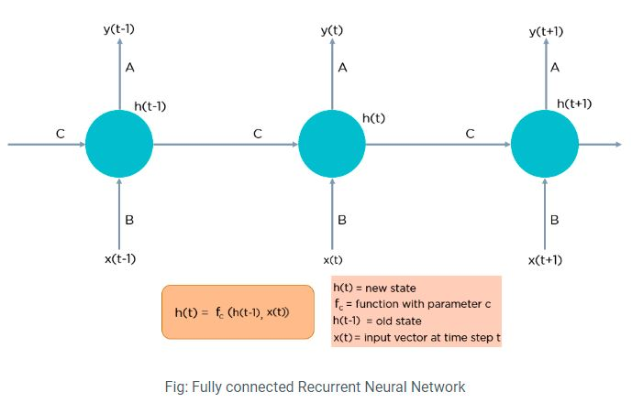
Recurrent Neural Network (RNN)

Slide 3
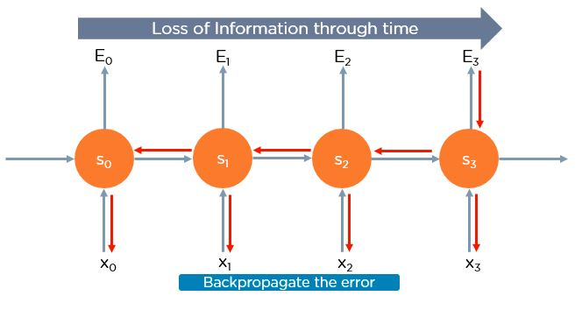
Two Issues of Standard RNNs
1. Vanishing Gradient Problem
2. Exploding Gradient Problem

Slide 4
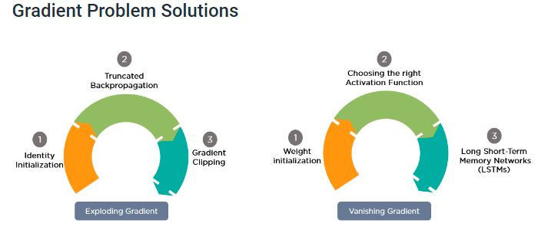

Slide 5
Long Short-Term Memory Network (LSTMs).
First, let’s understand Long-Term Dependencies.
Suppose you want to predict the last word in the text: “The clouds are in the ______.”
The most obvious answer to this is the “sky.”
We do not need any further context to predict the last word in the above sentence.
Consider this sentence:
“I have been staying in Spain for the last 10 years…I can speak fluent ______.”

Slide 6
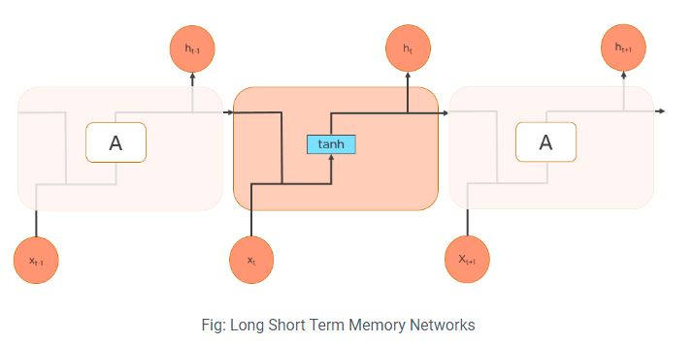
Recurrent Neural Network (RNN)

Slide 7
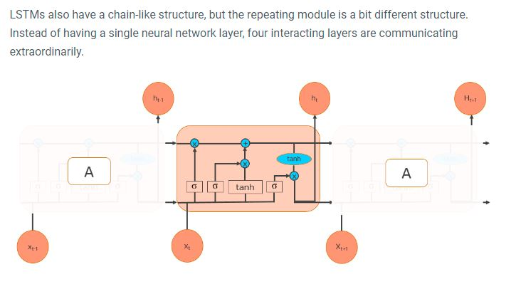
Structure of LSTM

Slide 8
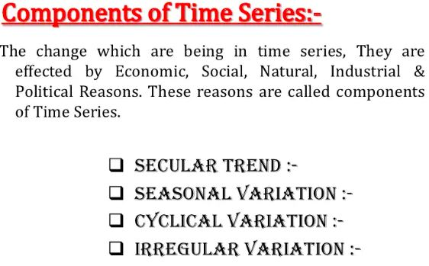
Why organizations use time series data analysis
Time series analysis helps organizations understand the underlying causes of trends or systemic patterns over time. Using data visualizations, business users can see seasonal trends and dig deeper into why these trends occur.

Slide 9

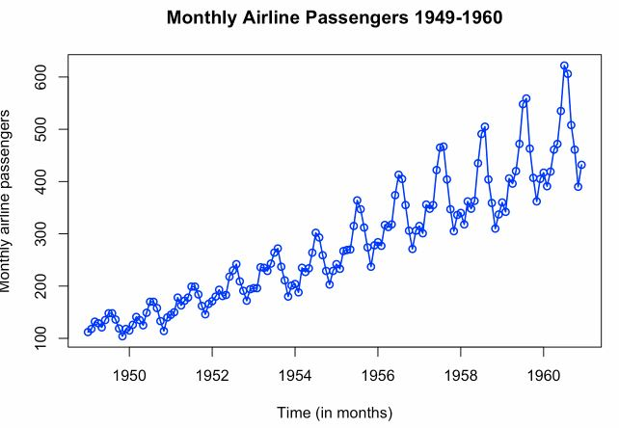

Slide 10
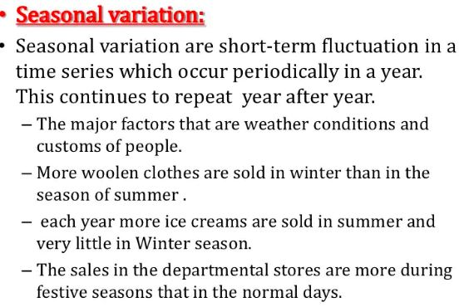
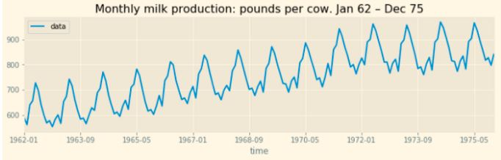

Slide 11
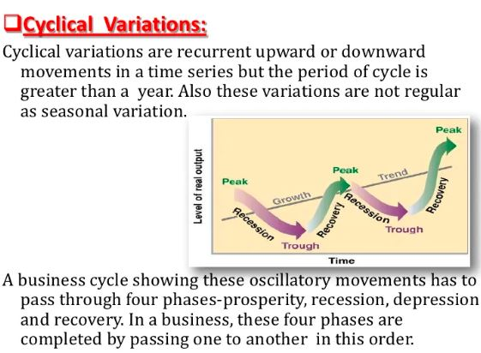
These are due to the business cycle and every organization has to phase all the four phases of a business cycle some time or the other. Prosperity or boom, recession, depression, and recovery are the four phases of a business cycle.

Slide 12
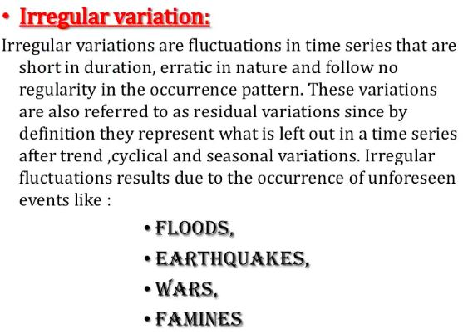

Slide 13
CASE STUDY OF TIME SERIES
EMD (Empirical Mode Decomposition) is an adaptive time-series analysis method suitable for processing series that are non-stationary and non-linear.
EMD performs operations that partition a series into 'modes' (IMFs; Intrinsic Mode Functions) without leaving the time domain. It can be compared to other time-space analysis methods like Fourier Transforms and wavelet decomposition.
Hilbert transform: The Hilbert transform is important in signal processing, where it is a component of the analytic representation of a real-valued signal u(t).

Slide 14
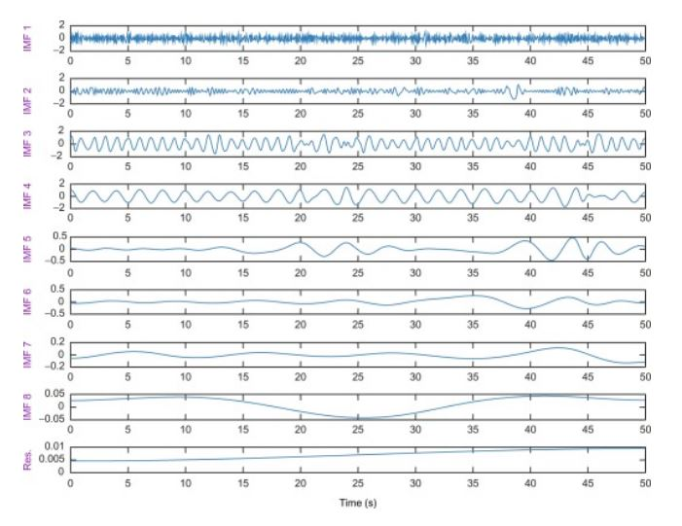

Slide 15

In EMD algorithm any complicated data set can be decomposed into a finite and often small number of IMF.
Algorithm for EMD
1. Find out local extrema for given signal X (t).
2. Individually connect all maxima and minima (extrema) with the help of cubic spline lines to form upper and lower envelopes, U (t) and L (t) respectively.
3. Find mean as, M (t) = [U (t) + L (t)] /2.
4. Obtain the mean subtracted data from the signal data as a-IMF, H1 (t) = X (t) – M (t).
5. Check the early-IMF for the definition of the IMF.
6. If early-IMF H1 (t) does not satisfies the IMF definitions i.e. it is not IMF repeat
Step I to step V on H1 (t) till it does not meet the definitions of being IMF after summing up all above steps, we obtained [17].
Where n is the number of extracted IMFs and rn is the residue.

Slide 16
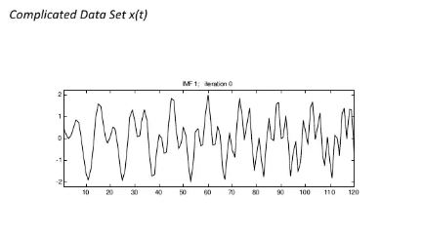
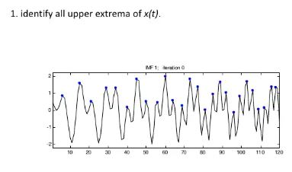
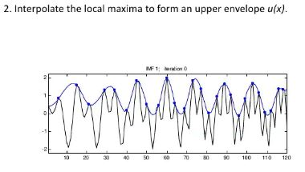
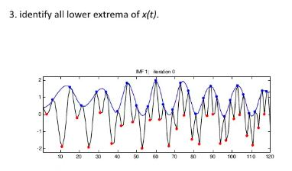
Step by Step process of EMD

Slide 17
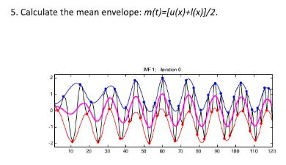
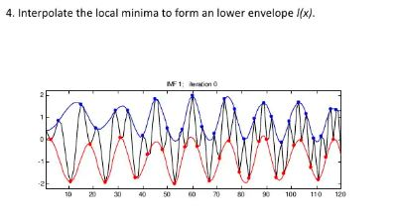
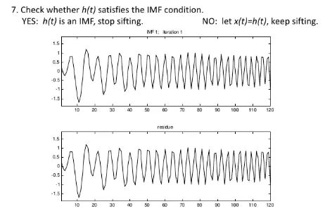

Slide 18
Dimension Reduction method

